Slide 1
BANGLORE NATIVE FOOD
NAME : DARSHAN SP MY TOPIC : MUDDE BASARU
CLASS : CSE “A” SEC
USN : 1JT21CS038

Slide 2
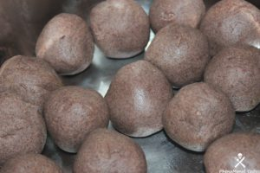
MUDDE BASARU

Slide 3
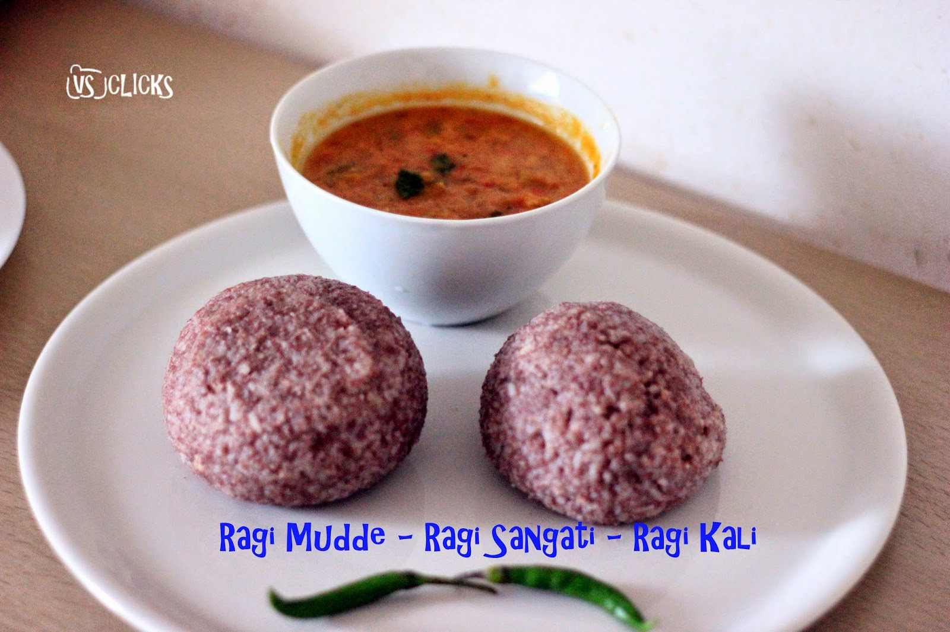
INGREDIENTS
For Bassaru
Dill Leaves as required
Spinach as required
1 cup yellow split pigeon pea
2 tsp poppy seeds
1 tsp black peppercorns
4 red chillies
3 tsp grated coconut
1 chopped onion
Curry leaves
salt to taste
1 tsp turmeric powder
For Ragi Mudde
1 cup ragi flour
1/2 cup water
2 tsp ghee

Slide 4
PREPARATION
In a pressure cooker, add dill leaves, fresh spinach, 1 cup yellow split pigeon pea, 1 tsp turmeric powder, salt to taste, water as required and pressure cook for 3 whistles.
After it gets cooked, filter the water in a pan and let it boil.
Take 2 tsp poppy seeds, 1 tsp black peppercorns, 4 red chillies, ¼ cup chopped coconut, and 1 chopped onion in a blender jar. Blend to a smooth paste.
Add the spice masala paste in bassaru broth, let it boil for few minutes. Bassaru is ready to serve now.
Mix 1 cup ragi in ½ cup water to make ragi batter.
Heat a pan, pour ragi batter as required.
Stir well to avoid any lumps.
Now add 1 tsp ghee, and cook until the raw smell of ragi goes away.
Once the mixture cools down, grease your palms with ghee and roll the dough to balls.
Ragi mudde is ready to serve.

Slide 5
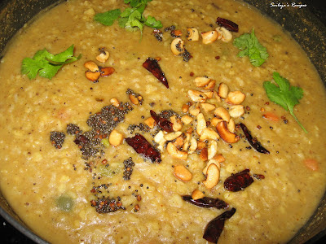
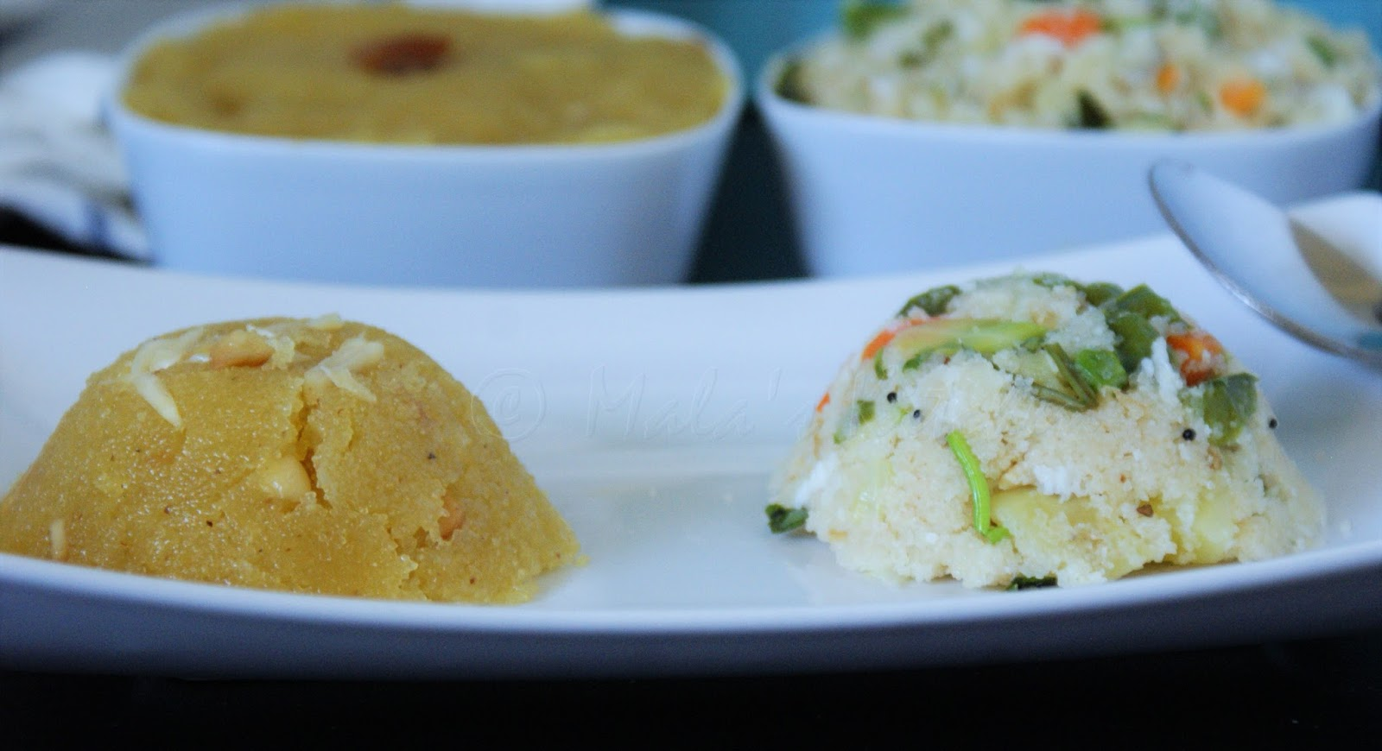
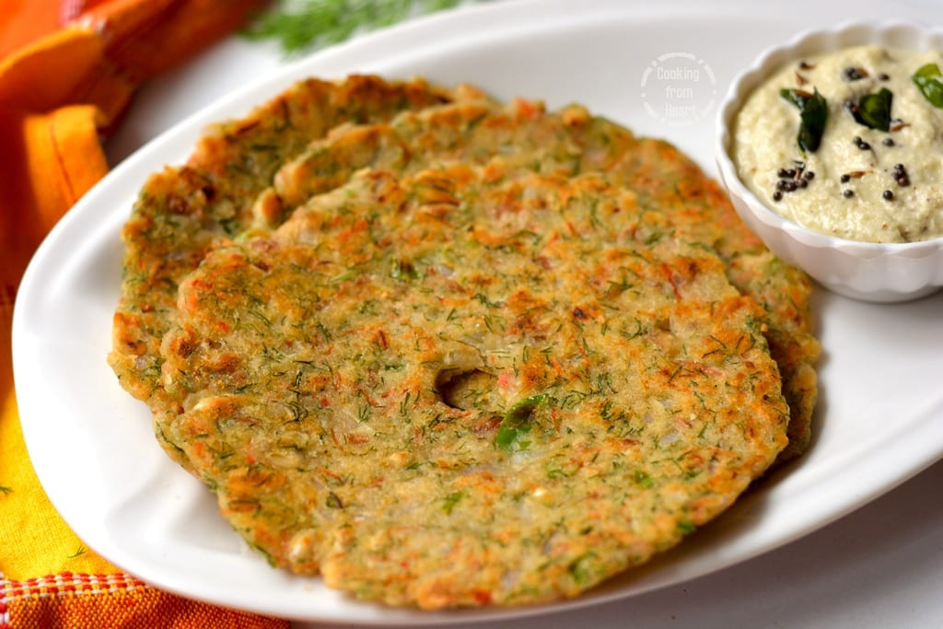
Famous Foods of Bangalore
Rava Idli
2 .Bisi Bele Bath
3.Mangaluru Buns
4.Obbattu
5.The Famous Hoskote Biryani
6.Shavige Bath
7.Khanavali Utta and Bale Yele Meals
8.Akki Roti
9. Chow Chow Bath

Slide 6
Benefits and Advantages of including Ragi mudde in the diet
1. Weight Loss
It contains the rare amino acid known as Tryptophan known for reducing the appetite. They also contain protein and healthy carbs. The high fiber content in the ragi balls can reduce the hunger pangs. The biggest benefit is, presence of low unsaturated fats which make it ideal for a weight loss recipe.
2. Good For Bones
It makes the bones strong. Ragi contains Calcium with Vitamin D in large amounts. A regular consumption of ragi balls during the old age, helps to prevent osteoporosis. The vitamins and amino acids assist in maintaining the metabolic rate. They also boost the development of growth hormones for proper health. The dietary fibers help to maintain proper digestion. It also enhances the circulation of blood in the body. It also helps to smoothen movements of bowel and better metabolism.
Advertisements
3. Diabetics
Many youngsters suffer from the ill-effects of diabetes in recent times. This dish reduces the symptoms of the disease as well gastrointestinal disorders. The main reason is because of fibers and polyphenols. The fiber content lowers the sugar level and the rate of digestion. The low glycaemic index prevents overeating and unwanted cravings in the midnight.
4. Reduces Cholesterol
The amino acids present in ragi can bring down the cholesterol levels. They eradicate the unwanted fat from the liver. So, the formation of plague levels in the heart and liver gets reduced. In turn, you do not suffer from hypertension and heart-related diseases.

Slide 7
Medicinal values
Keeps Blood Sugar Levels In Check
Finger millet, although being high in calories and carbohydrates for instant energy, also comprises a plethora of phytates, tannins, polyphenols – plant chemicals that slow down the digestion process. This lowers high blood sugar in those with diabetes mellitus, making ragi a valuable addition to a diet for diabetes. Also, owing to its low digestibility and rich fiber content, ragi is the top food of choice for adults, for accelerating weight loss and managing other lifestyle diseases like diabetes and obesity.

Slide 8
THANK YOU

